Slide 1





The British College, Kathmandu
Taste Best
Pioneering an eccommerce PLatform
A Presentation by:
Team 2
Team Members
*Sabdika Ghimire
*Yogesh Bhattarai
*Bidya Joshi
*Ashish Pandey
*Aditya Shah
*Shivam Shah
Presented to:
Mr. Rohit Raj Pandey

Slide 2

Introduction to Website (Taste Best)
This website is an e-commerce website for the customers and traders of Cleckhuddersfax. This system lend a helping hand to local people who are unable to purchase goods locally during the regular opening hours. The website works with PHP programming, oracle apex, UI/UX design, JQuery and so on. Trader and Management Interface is also embedded in this ecommerce website and is strictly responsive. Customers can save their time with the utilization of timeslot.

Slide 3

Five Phases of Project Management
Project Execution Phase
Project Initiation Phase
Monitoring and Controlling Phase
Phases of Project Management
Project Planning Phase
Project Closeout Phase

Slide 4

Project Initiation Phase
Initiation Phase
Project Charter
Meeting Minutes
Version Control
Project Justification
Project Scope
Project Assumption
Roles and Responsibilities

Slide 5
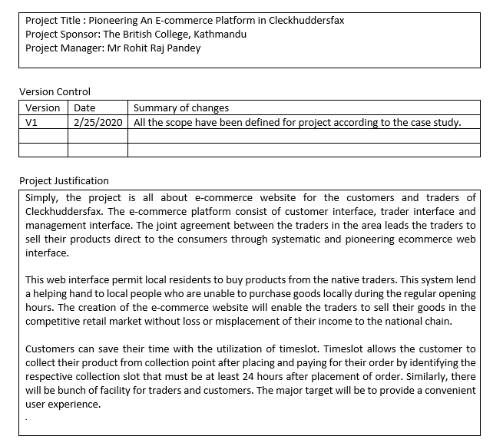

Project Charter Version 1
Project Justification

Slide 6
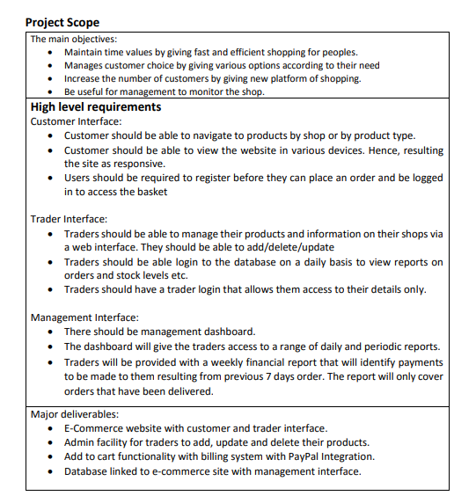
Project Charter Version 1
Trader Interface
Main Objectives
Management Interface
Project Scope
Customer Interface
Major Deliverables

Slide 7

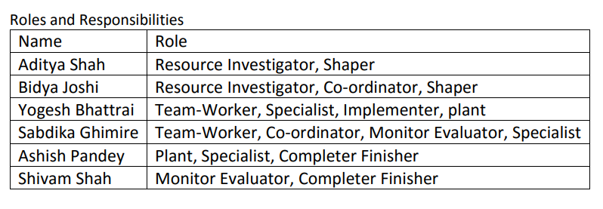
Project Charter Version 1
Roles and Responsibilities
A key factor for project completion

Slide 8
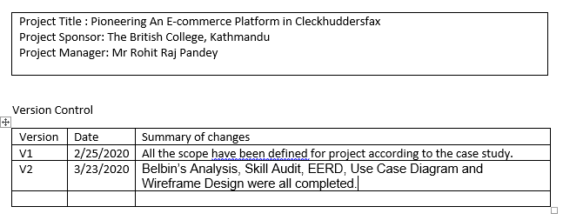
Project Charter Version 2
Version Control

Slide 9

Project Planning Phase
Planning Phase
Belbin’s Analysis
Skill Audit
MS Project
Communication Tools

Slide 10
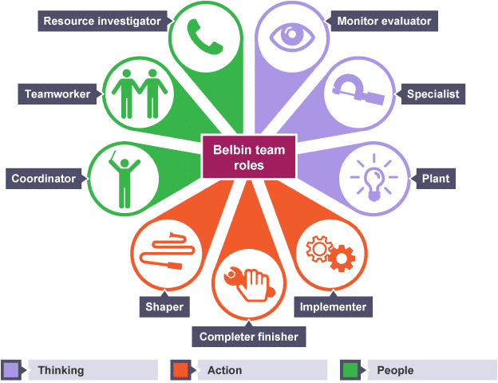
Project Planning Phase
Belbin’s Analysis
Primary Roles
Secondary Roles
Least Likely Role

Slide 11
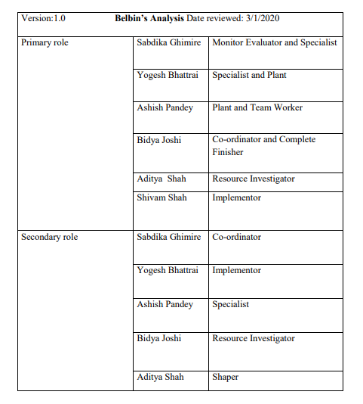

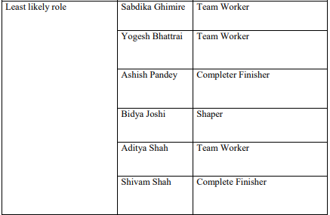
Project Planning Phase
Belbin’s Team Role

Slide 12
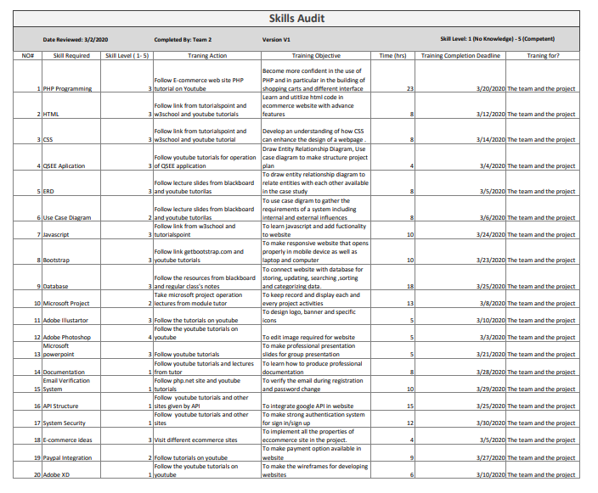
Project Planning Phase
Training Action
Skills Required
Training Objective
Skill Audit
Skill Level(0-5)
Time Required
Training Completion Deadline

Slide 13
Project Planning Phase
Microsoft Project
Timeline & Calendar
Gantt Chart
Resource Sheet
Microsoft Project is the world's most popular project management software. The application is designed to assist project team members in developing plans, assigning resources to tasks, tracking progress, managing budgets and analyzing workloads
Project Management (MS Project
Network Diagram
Project Task
Change Working Time

Slide 14
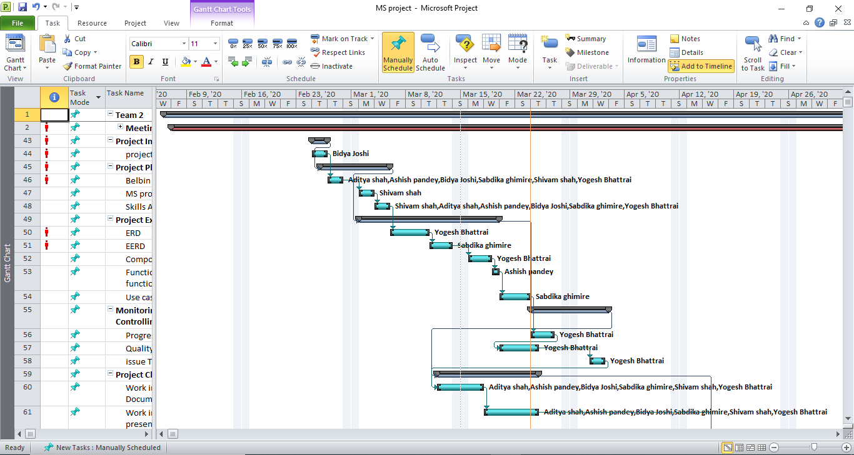
Microsoft Project
Gantt Chart 1
A Gantt chart, is a type of bar chart that illustrates a project schedule. This chart lists the tasks to be performed on the vertical axis, and time intervals on the horizontal axis.

Slide 15
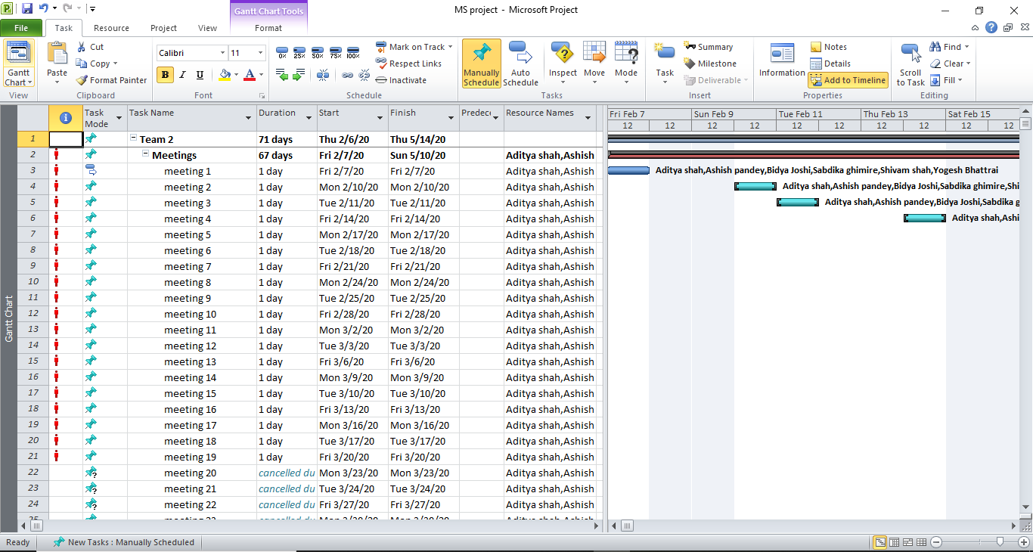
Microsoft Project
Gantt Chart 2
A Gantt chart, is a type of bar chart that illustrates a project schedule. This chart lists the tasks to be performed on the vertical axis, and time intervals on the horizontal axis.

Slide 16
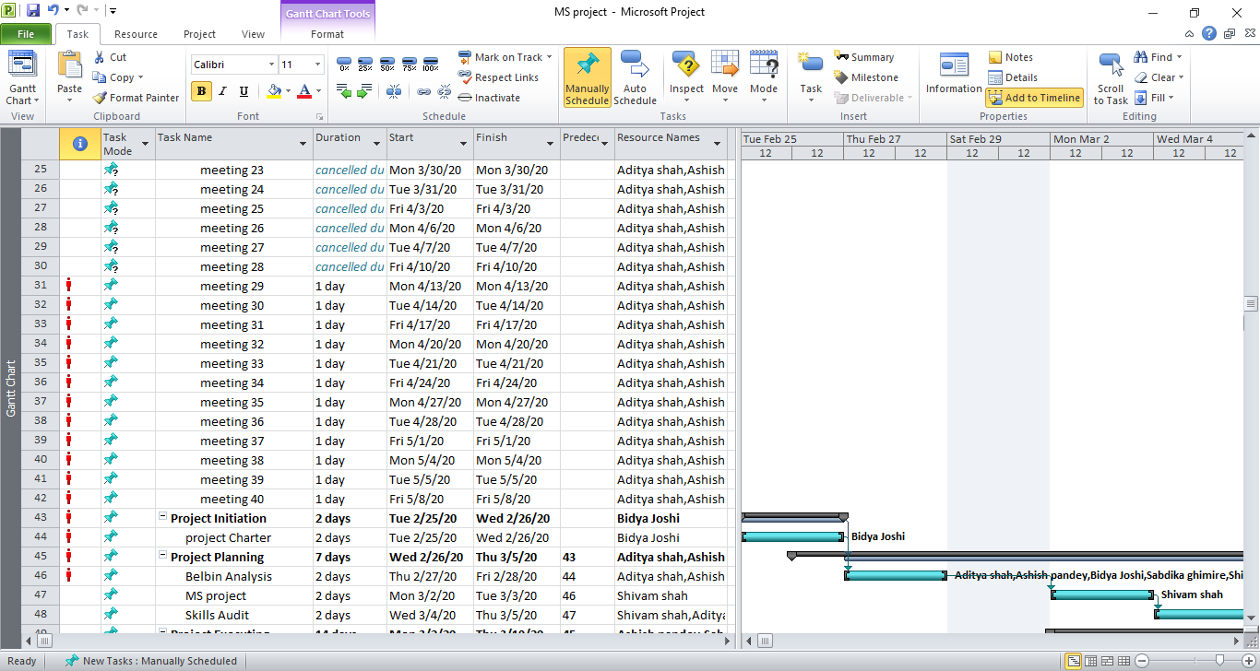
Microsoft Project
Gantt Chart 3
A Gantt chart, is a type of bar chart that illustrates a project schedule. This chart lists the tasks to be performed on the vertical axis, and time intervals on the horizontal axis.

Slide 17
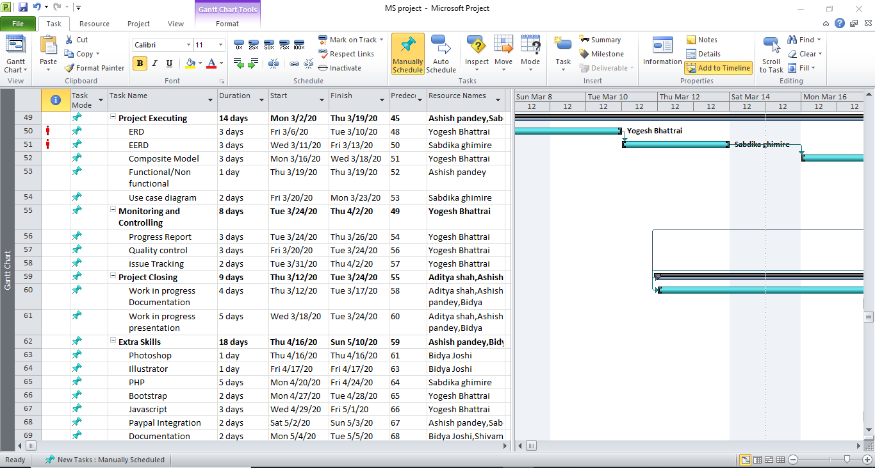
Microsoft Project
Gantt Chart 4
A Gantt chart, is a type of bar chart that illustrates a project schedule. This chart lists the tasks to be performed on the vertical axis, and time intervals on the horizontal axis.

Slide 18
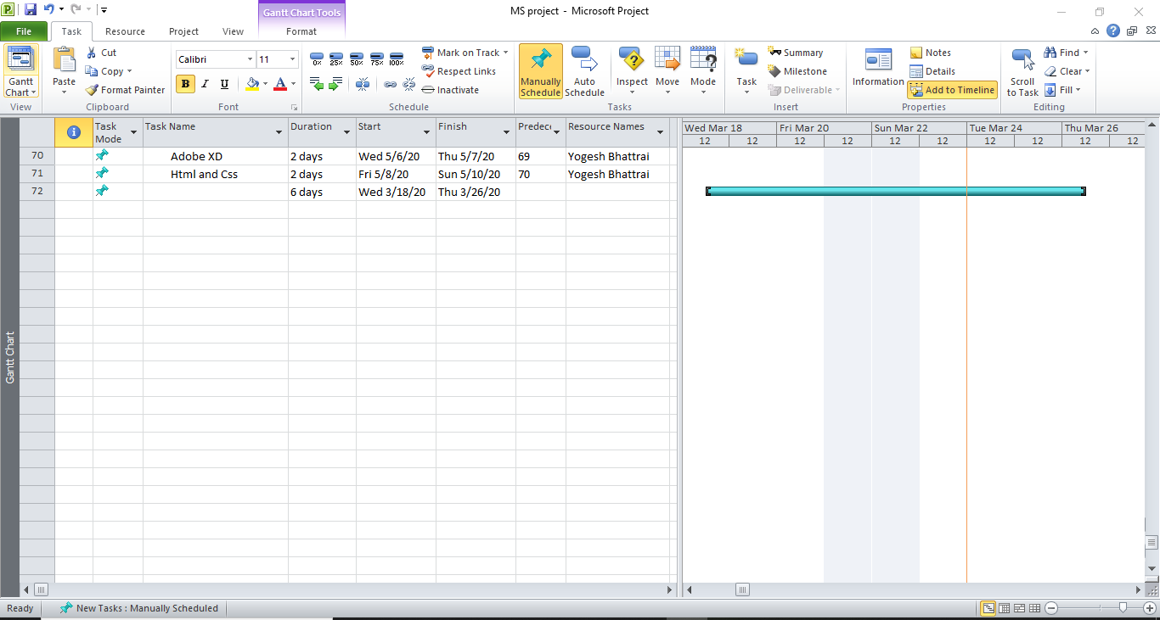
Microsoft Project
Gantt Chart 5
A Gantt chart, is a type of bar chart that illustrates a project schedule. This chart lists the tasks to be performed on the vertical axis, and time intervals on the horizontal axis.

Slide 19
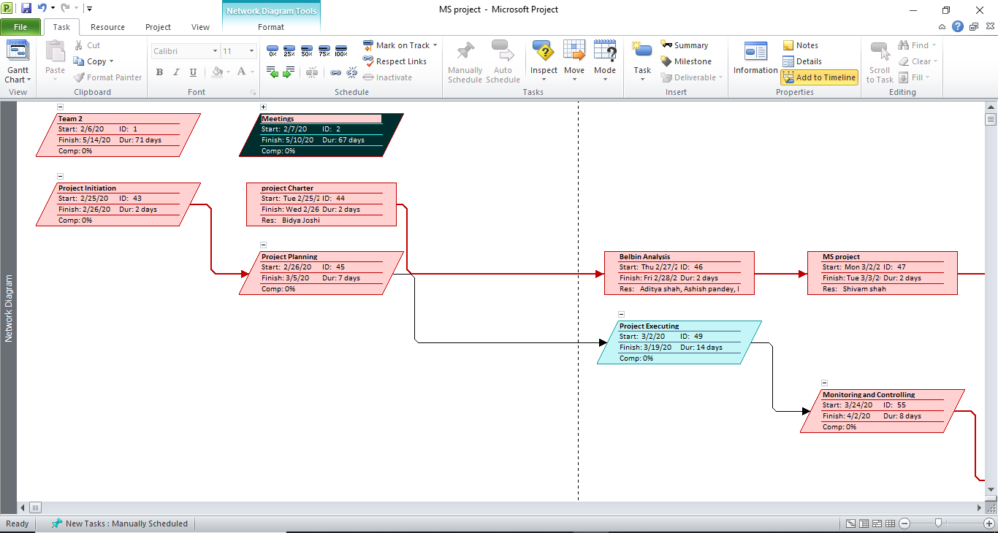
Microsoft Project
Network Diagram 1
A network diagram is a graphical representation of all the tasks, responsibilities and work-flow for a project. It often looks like a chart with a series of boxes and arrows.

Slide 20
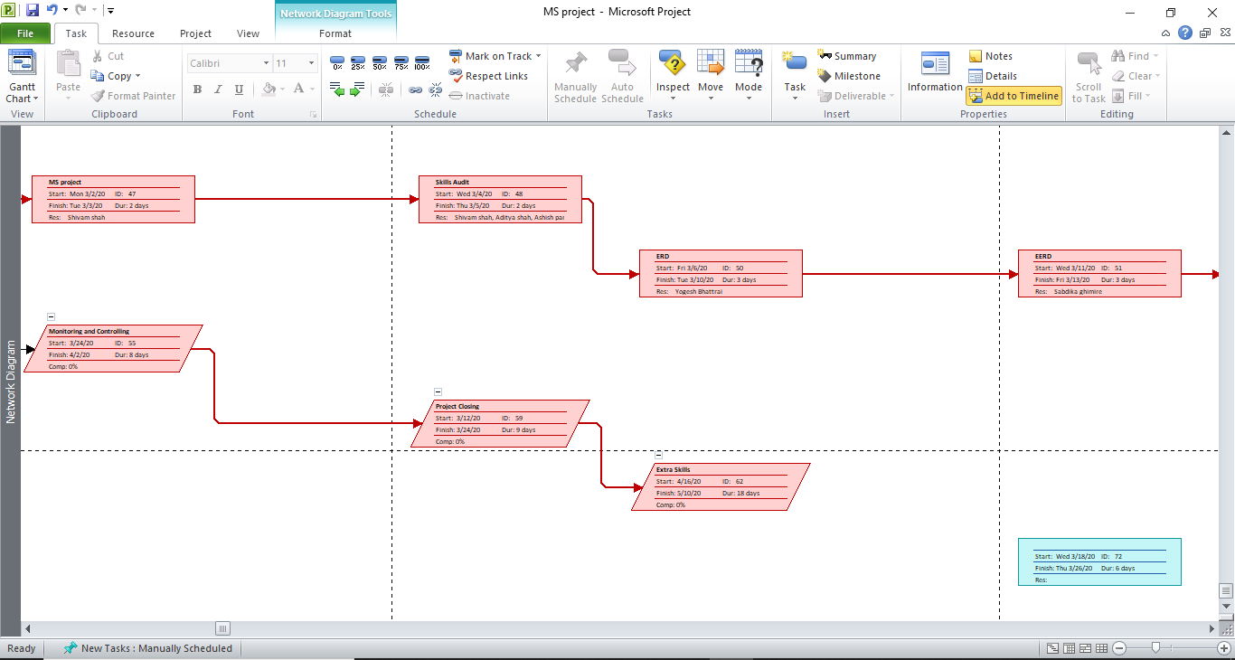
Microsoft Project
Network Diagram 2
A network diagram is a graphical representation of all the tasks, responsibilities and work-flow for a project. It often looks like a chart with a series of boxes and arrows.

Slide 21
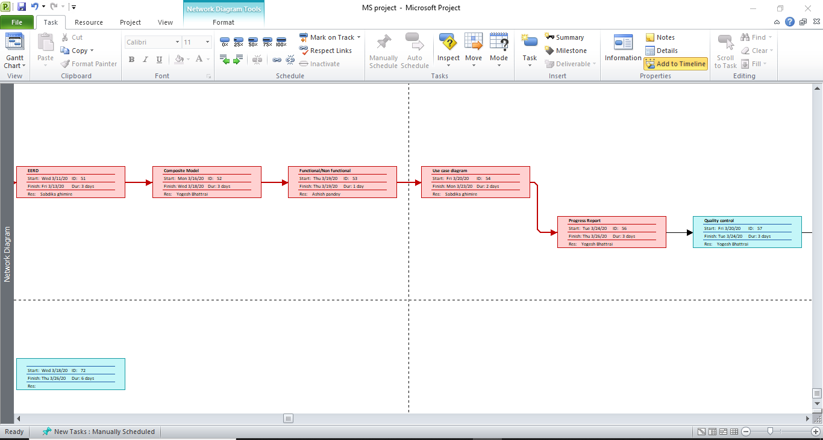
Microsoft Project
Network Diagram 3
A network diagram is a graphical representation of all the tasks, responsibilities and work-flow for a project. It often looks like a chart with a series of boxes and arrows.

Slide 22
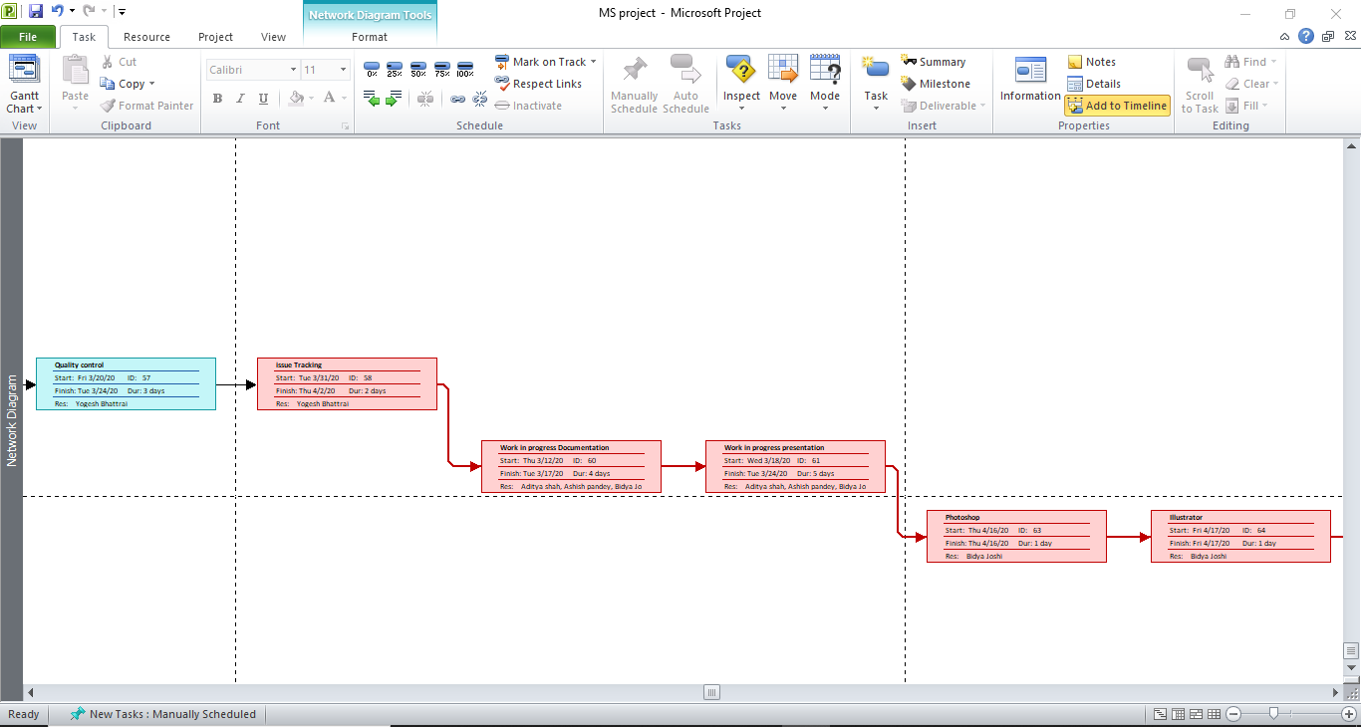
Microsoft Project
Network Diagram 4
A network diagram is a graphical representation of all the tasks, responsibilities and work-flow for a project. It often looks like a chart with a series of boxes and arrows.

Slide 23
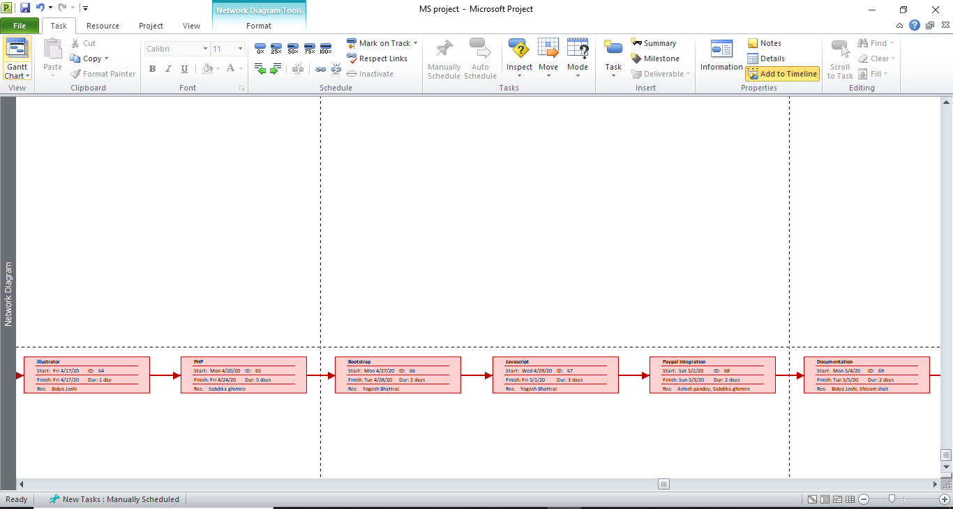
Microsoft Project
Network Diagram 5
A network diagram is a graphical representation of all the tasks, responsibilities and work-flow for a project. It often looks like a chart with a series of boxes and arrows.

Slide 24
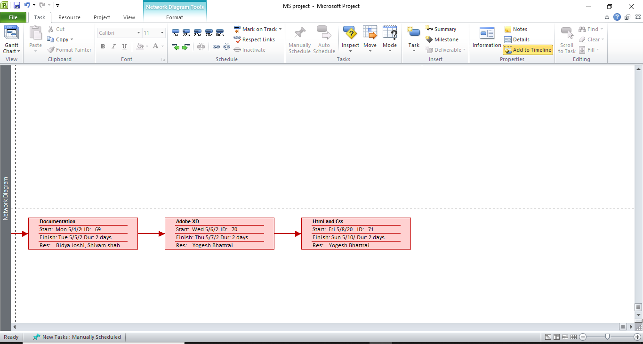
Microsoft Project
Network Diagram 6
A network diagram is a graphical representation of all the tasks, responsibilities and work-flow for a project. It often looks like a chart with a series of boxes and arrows.

Slide 25
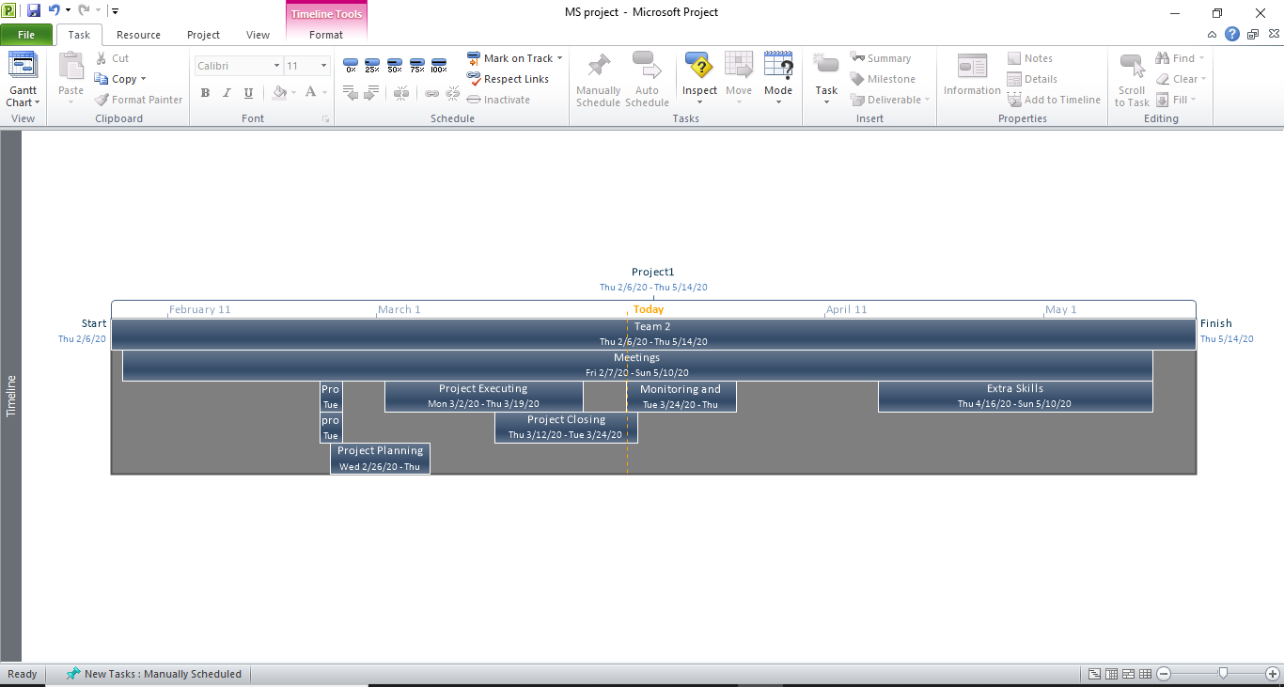
Microsoft Project
Timeline
A timeline can really help you out when you need to report “big picture” project information. It's a professional-looking snapshot of key tasks and milestones.

Slide 26
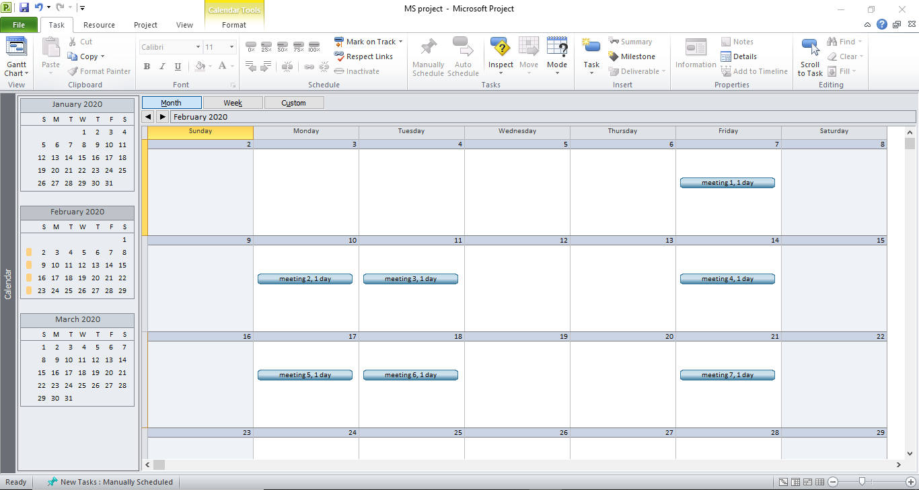
Microsoft Project
Calendar 1
The project calendar defines the working and nonworking days and times for tasks. Project uses this calendar to schedule tasks that do not have resources assigned or that have a task type of fixed duration.

Slide 27
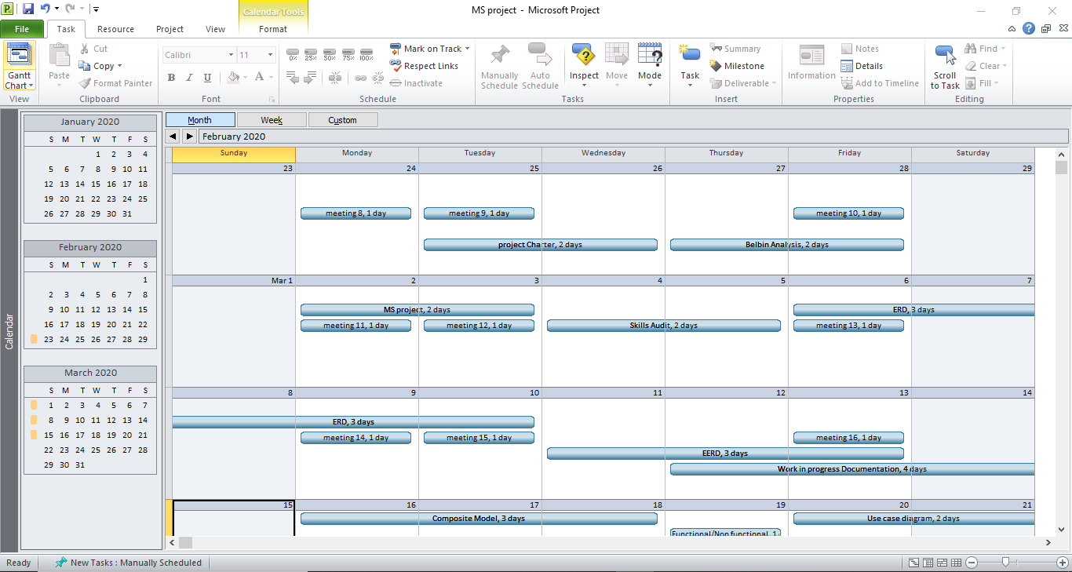
Microsoft Project
Calendar 2
The project calendar defines the working and nonworking days and times for tasks. Project uses this calendar to schedule tasks that do not have resources assigned or that have a task type of fixed duration.

Slide 28
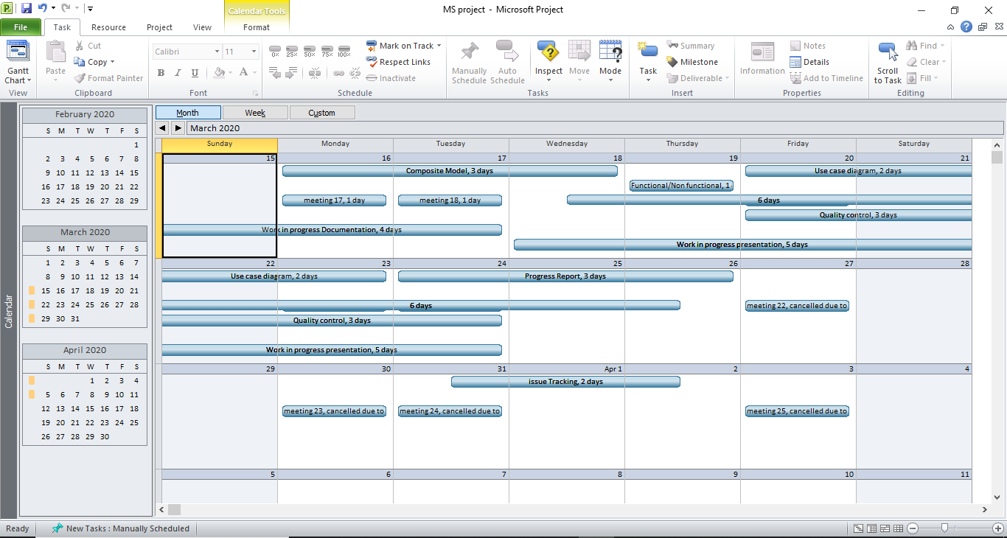
Microsoft Project
Calendar 3
The project calendar defines the working and nonworking days and times for tasks. Project uses this calendar to schedule tasks that do not have resources assigned or that have a task type of fixed duration.

Slide 29
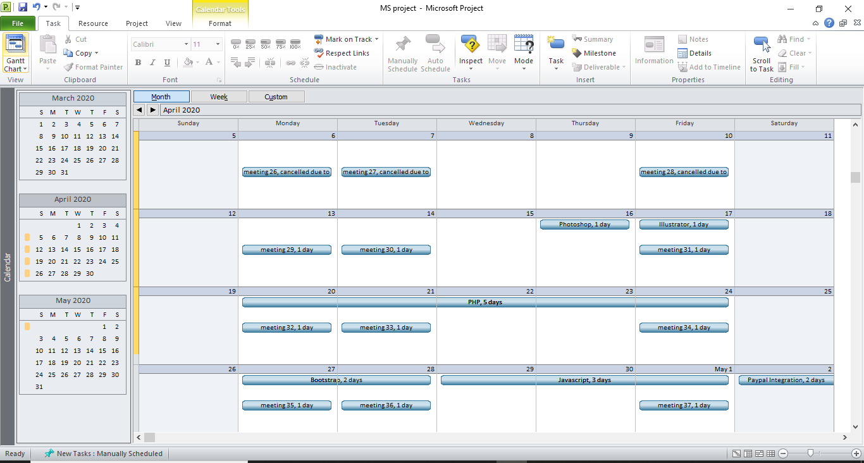
Microsoft Project
Calendar 4
The project calendar defines the working and nonworking days and times for tasks. Project uses this calendar to schedule tasks that do not have resources assigned or that have a task type of fixed duration.

Slide 30
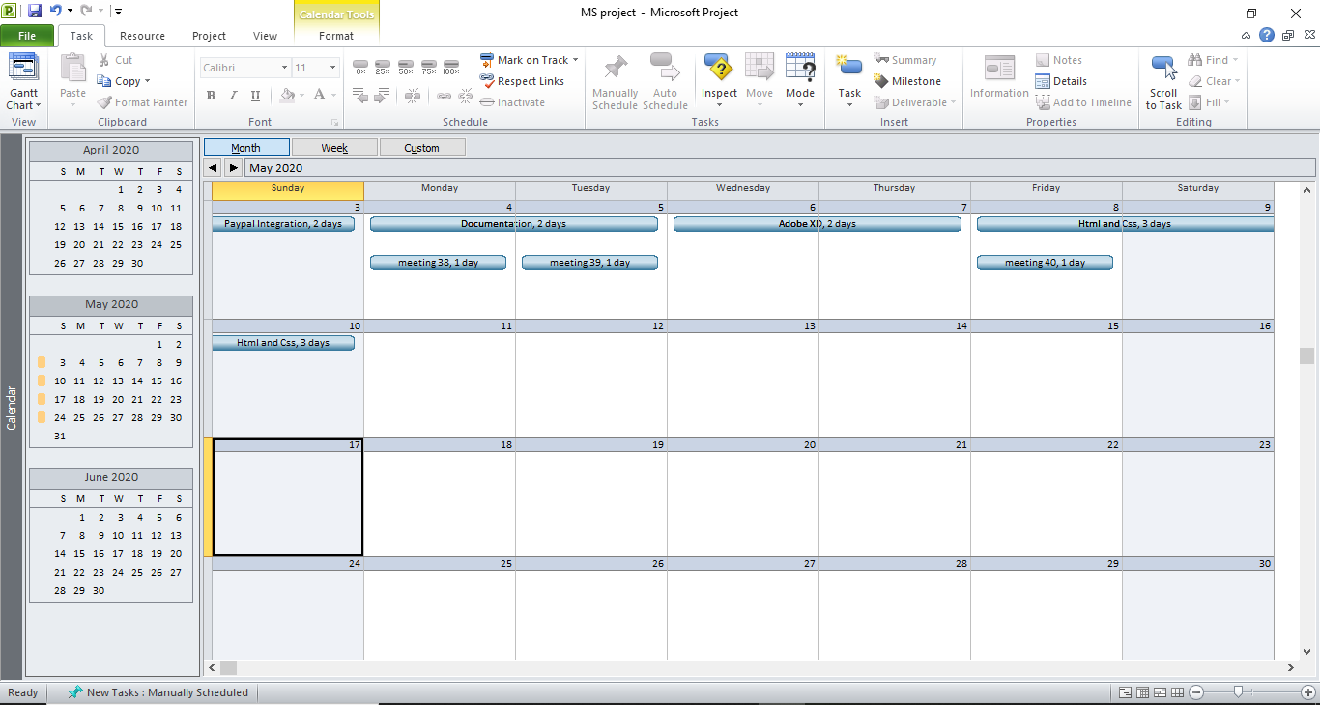
Microsoft Project
Calendar 5
The project calendar defines the working and nonworking days and times for tasks. Project uses this calendar to schedule tasks that do not have resources assigned or that have a task type of fixed duration.

Slide 31
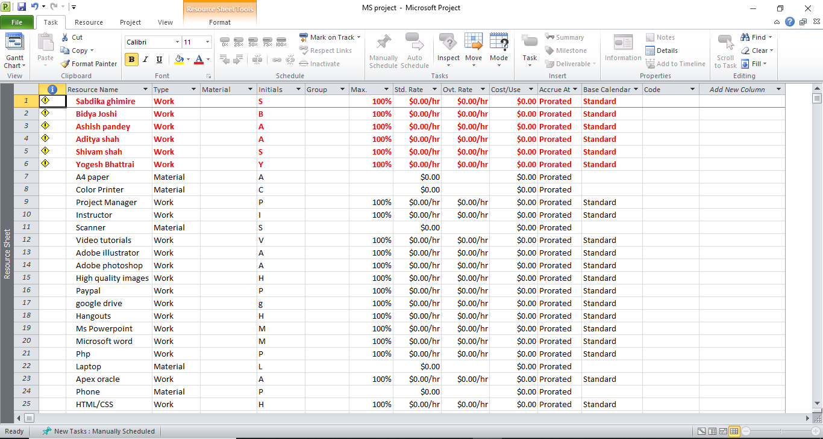
Microsoft Project
Resource Sheet 1
The Resource Sheet is a view within Project that allows the user to view, create, and edit resources and resource information. ...

Slide 32
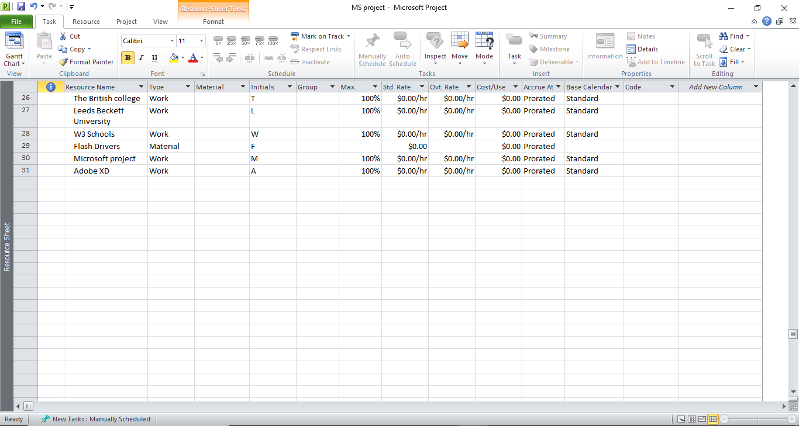
Microsoft Project
Resource Sheet 2
The Resource Sheet is a view within Project that allows the user to view, create, and edit resources and resource information. ...

Slide 33
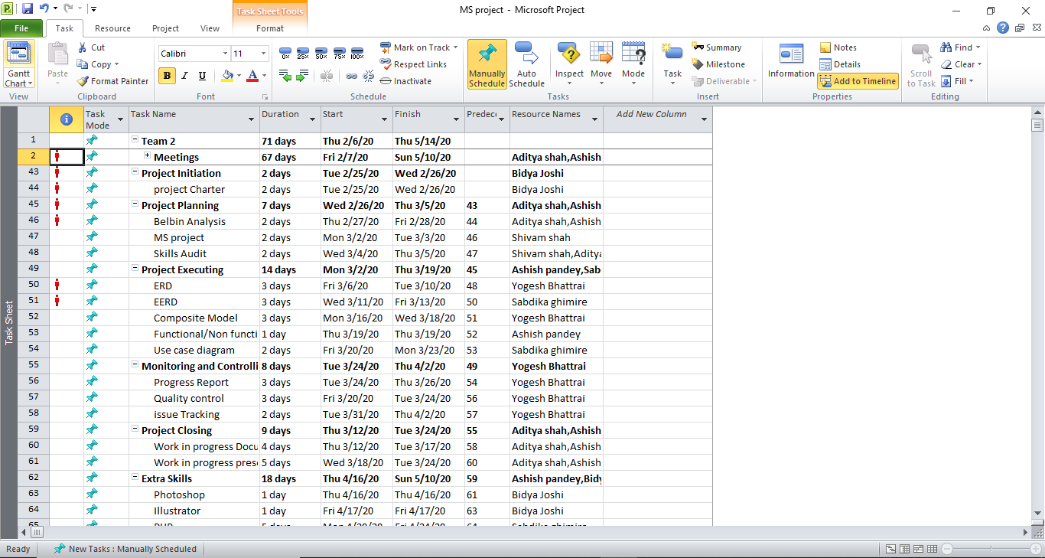
Microsoft Project
Project Task Sheet 1
In Microsoft Project, a task board is a tool that an individual, team, or organization uses to represent work and its completion path. This includes ongoing, completed, and upcoming tasks.

Slide 34
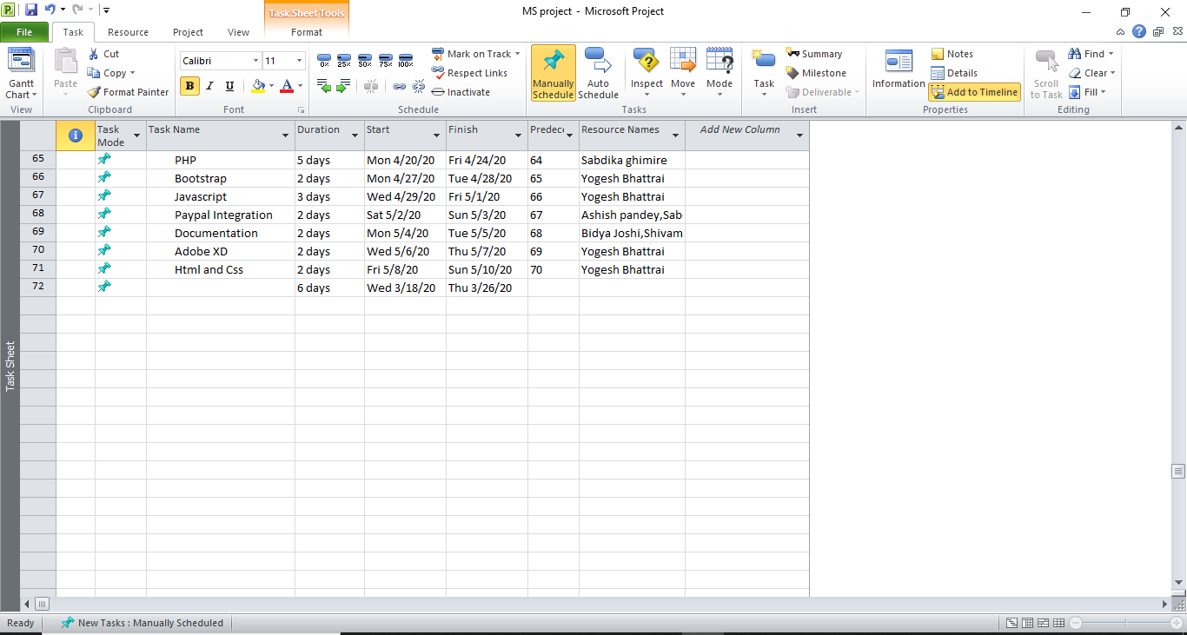
Microsoft Project
Project Task Sheet 2
In Microsoft Project, a task board is a tool that an individual, team, or organization uses to represent work and its completion path. This includes ongoing, completed, and upcoming tasks.

Slide 35
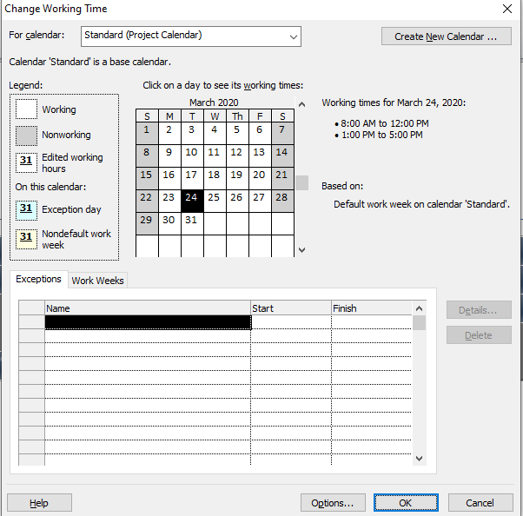
Microsoft Project
Change Working Time
In Project, the default time unit for work is hours, but you can change it to be minutes, days, weeks, or months. The entire process in change working time.

Slide 36



Project Planning Phase
Communication Tools
Hangouts
Google Drive
Gmail
Gmail

Slide 37
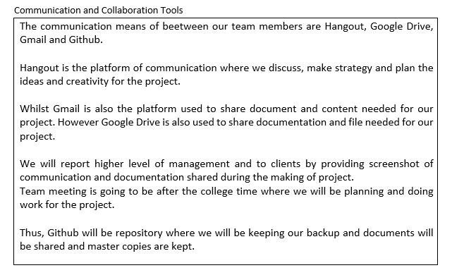

Communication Tools

Slide 38
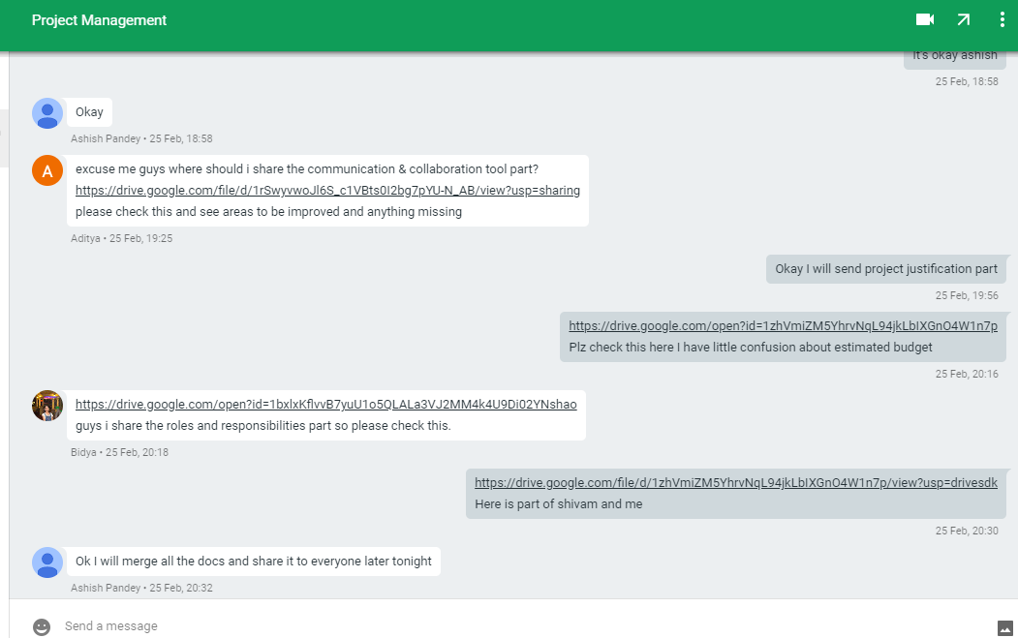
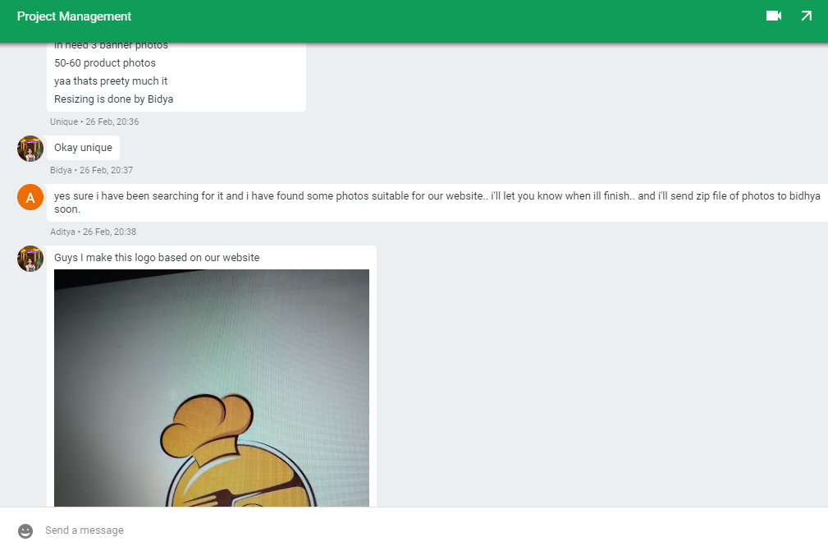
Utilization of Communication Tools

Slide 39

Project Execution Phase
Execution Phase
Entity Relationship Diagram
Use Case Diagram
Logo Design & Banner
Requirement Catalogue
Product Development
Wireframe

Slide 40
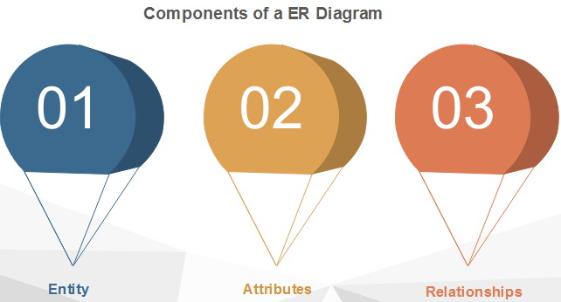
Entity Relationship Diagram
Entity Relationship Diagram
Final Composite Diagram
Entity Relationship Diagram
Extended Entity Relationship Diagram
Logical Diagram
Entity Attribute Relationship

Slide 41
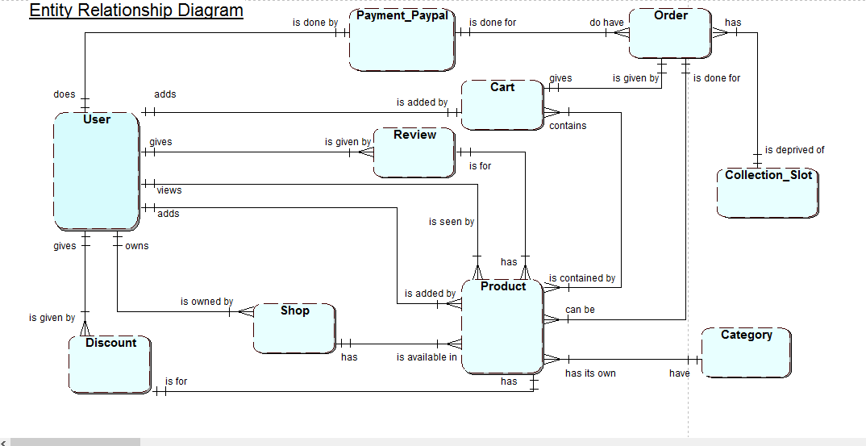
Entity Relationship Diagram

Slide 42
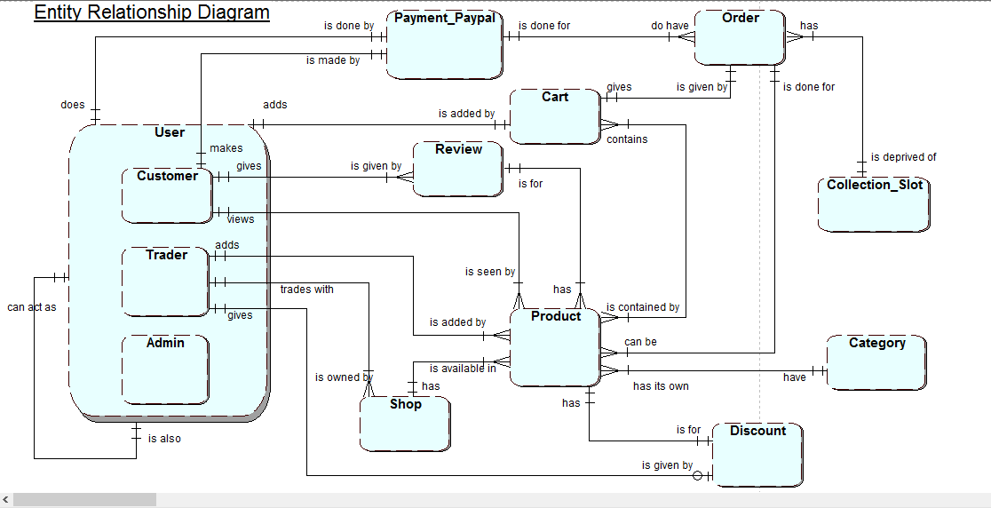
Extended Entity Relationship Diagram

Slide 43
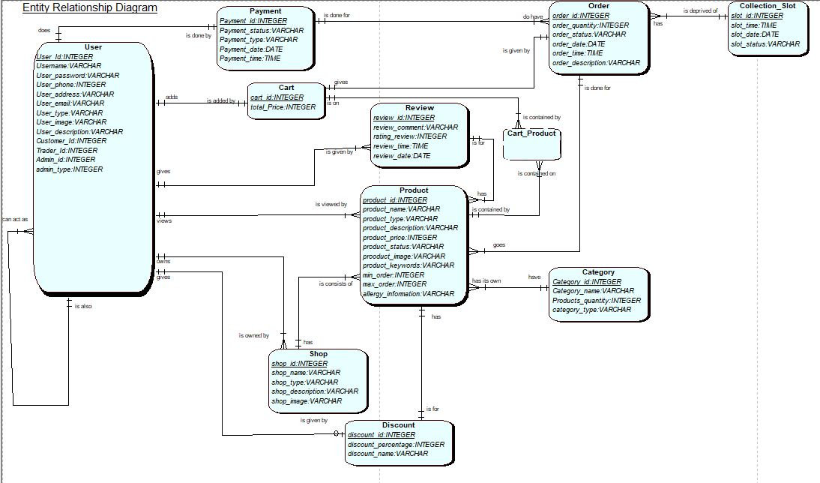
Final Composite Model

Slide 44
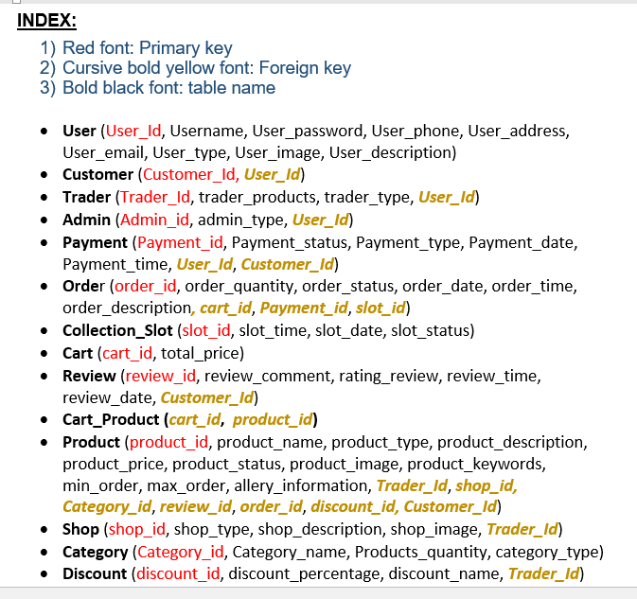
Logical Design
Components of Logical Design
Entity
Attribute
Primary key & Foreign Key

Slide 45
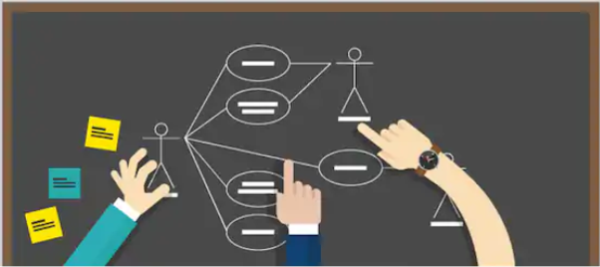
Use Case Diagram
Customer Use Case Diagram
Management Use Case Diagram
Use Case Diagram
Trader Use Case Diagram
Overview Use Case Diagram

Slide 46
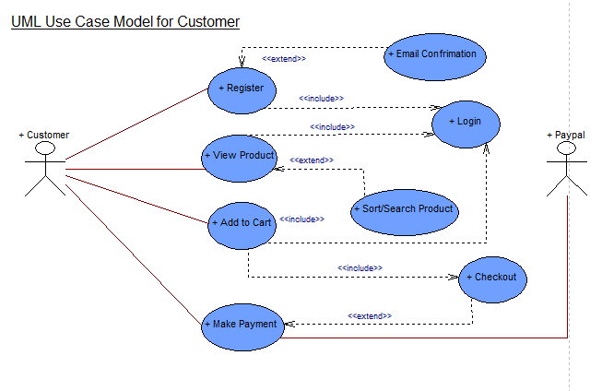
Customer Use Case Diagram

Slide 47
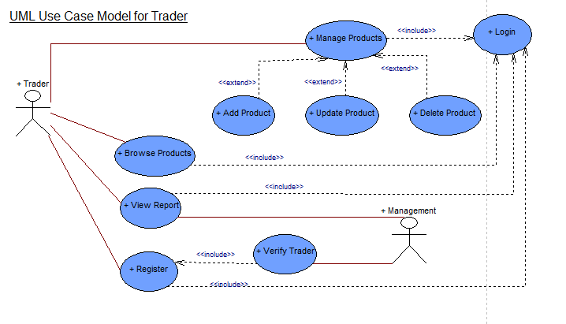
Trader Use Case Diagram

Slide 48
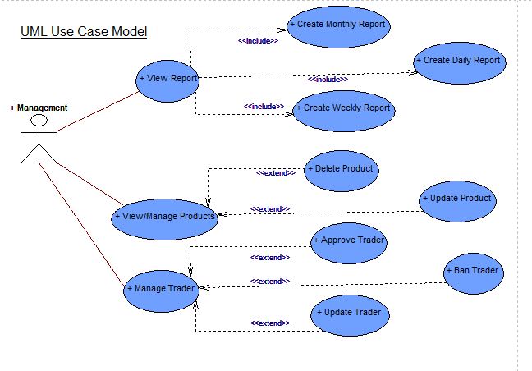
Management Use Case Diagram

Slide 49
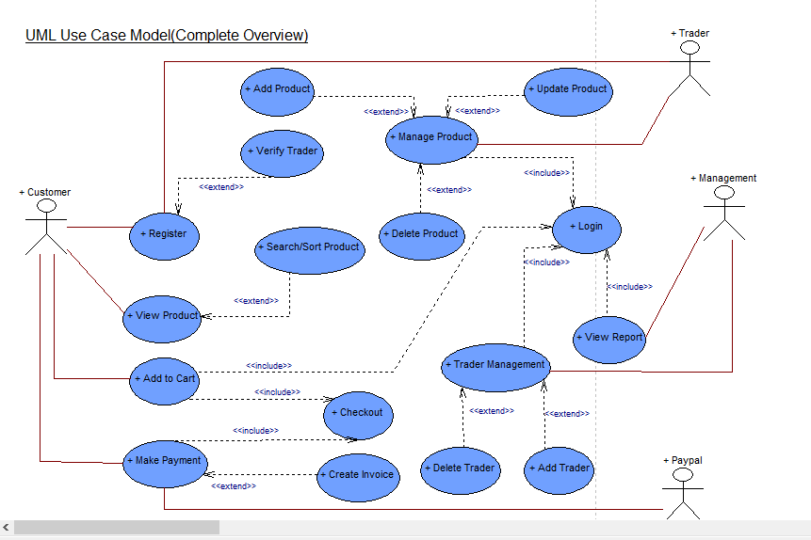
Overview Use Case Diagram

Slide 50
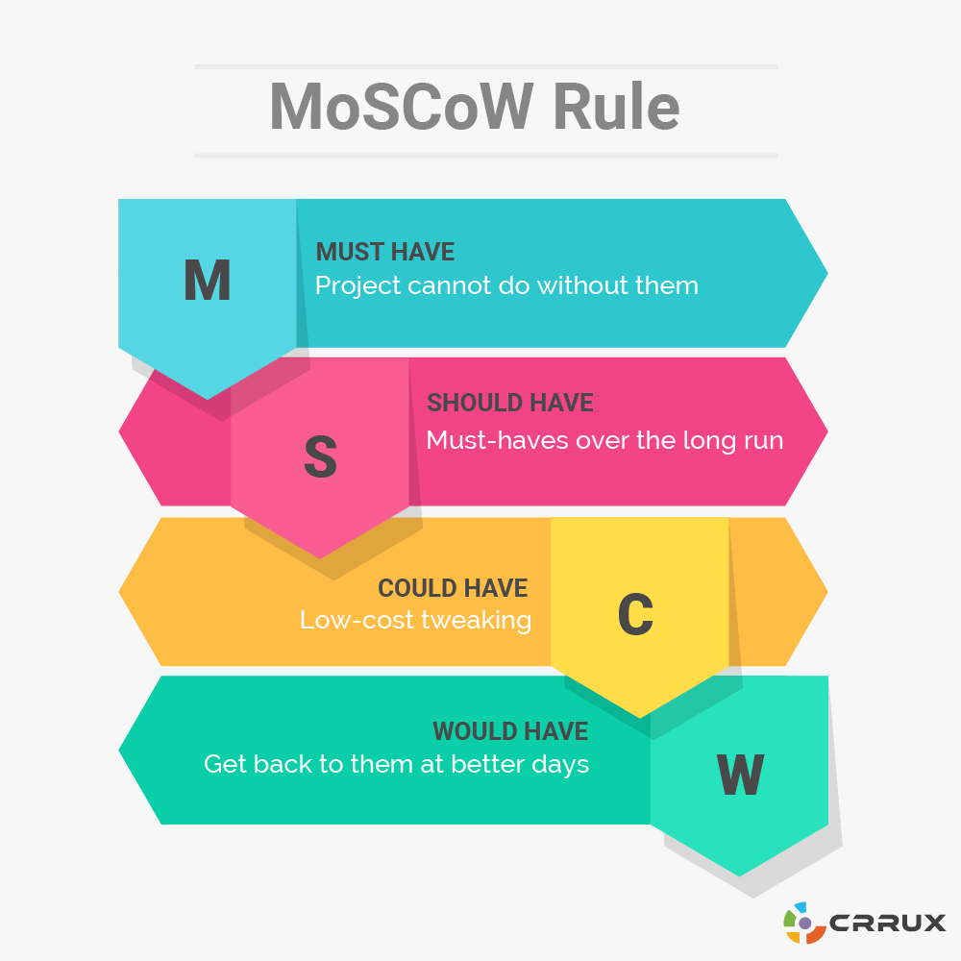
Project Execution Phase
Requirement Catalogue (MoSCoW)
Functional Requirement
Non Functional Requirement

Slide 51
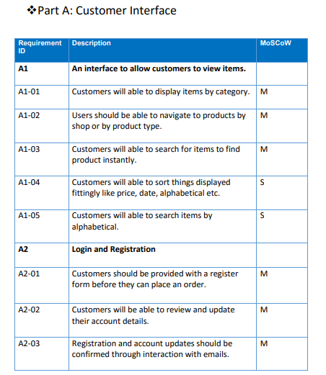
Requirement Catalogue
Functional Requirement
Customer Interface
Trader &User Interface
Management Interface

Slide 52
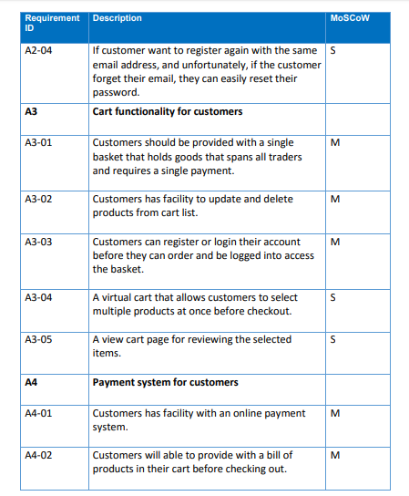
Functional Requirement Catalogue
Interface to view items
Cart Functionality
Customer Interface
Registration & Login
Payment System

Slide 53
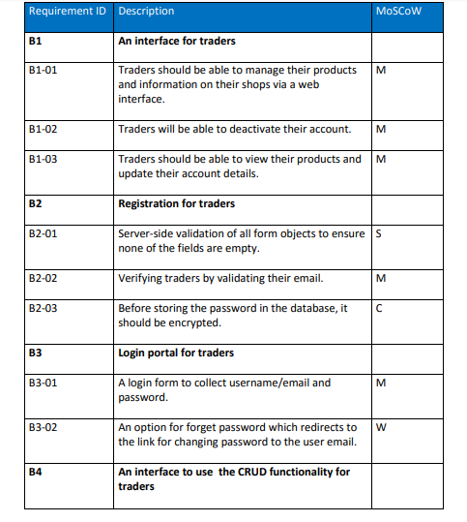
Functional Requirement Catalogue
Registration for trader
Cart Functionality
Trader Interface
Login Portal
Report & Accessibility

Slide 54
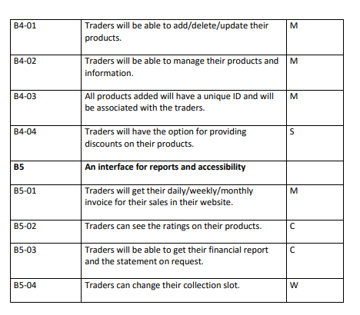
Functional Requirement Catalogue
Trader Interface

Slide 55
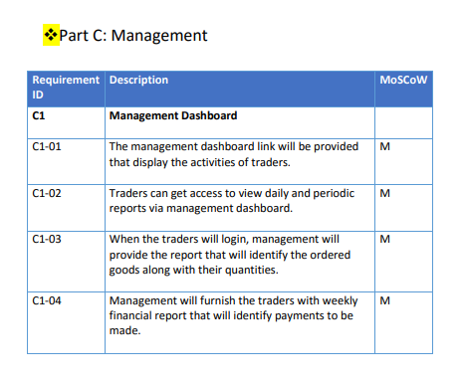
Functional Requirement Catalogue
Management Dashboard
Login Privilege
Management Interface
Management Accessibility

Slide 56
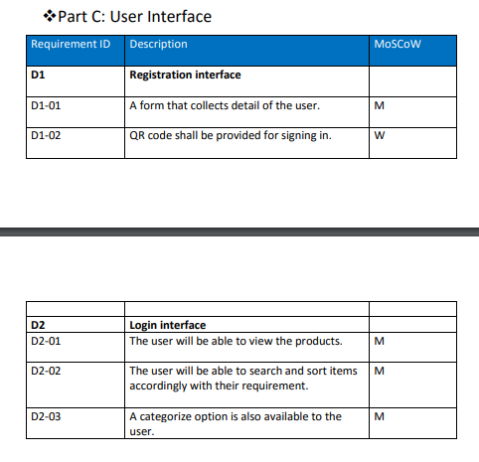
Functional Requirement Catalogue
User Interface
Registration Interface
Login Interface

Slide 57

Non Functional Requirement Catalogue
Non Functional
Web Interface
Miscellaneous Functions

Slide 58
Website Logo and Name
Website Name : Taste Best
Team Name : Team 2

Slide 59

Project Execution Phase
Banner for Website

Slide 60

Project Execution Phase
Banner for Website

Slide 61

Wireframe
Product Page
Home Page
Admin Dashboard
Wireframe
Registration/Login Page
Trader Page
Trader Dashboard

Slide 62


Wireframe for Home Page
Wireframe for Product Page

Slide 63

Wireframe for Registration/Login Page

Slide 64

Wireframe for Admin Dashboard

Slide 65


Wireframe for Trader Page
Wireframe for Trader Dashboard

Slide 66

Project Execution Phase
Product Development(Work In Progress)
Database Table in Oracle
Website Homepage

Slide 67

Product Development
User Table

Slide 68

Product Development
Shop Table

Slide 69

Product Development
Category Table

Slide 70

Product Development
Product Table

Slide 71

Product Development
Discount Table

Slide 72

Product Development
Cart Table

Slide 73

Product Development
Order Table

Slide 74

Product Development
Payment Table

Slide 75

Product Development
Collection Slot Table

Slide 76


